Slide 1
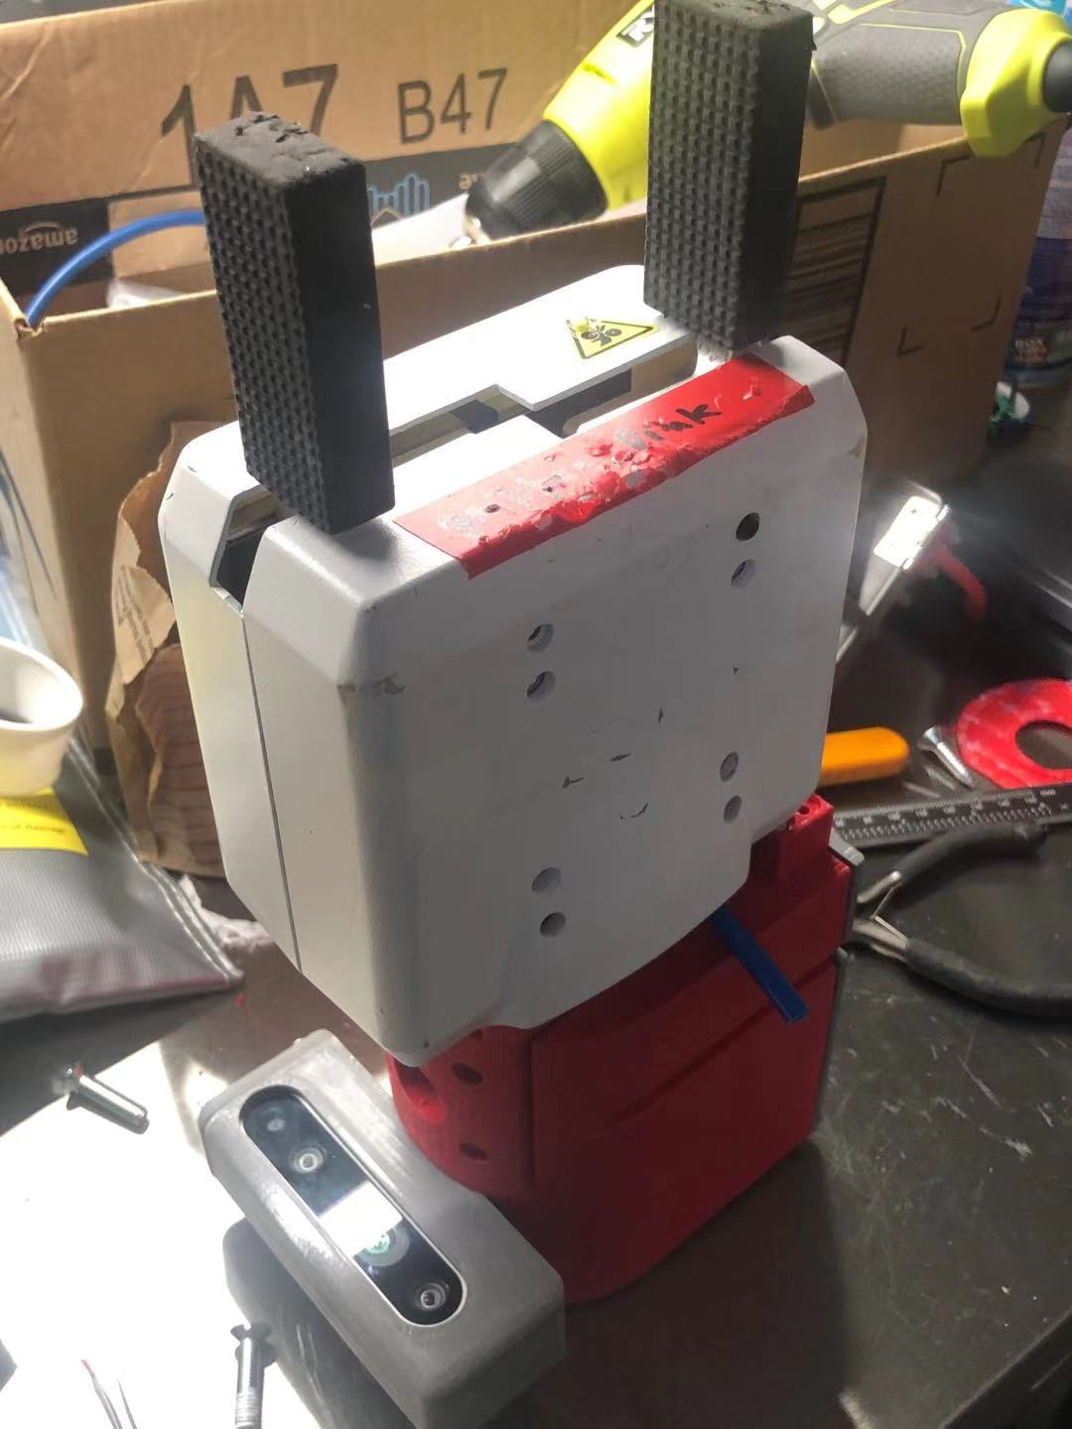
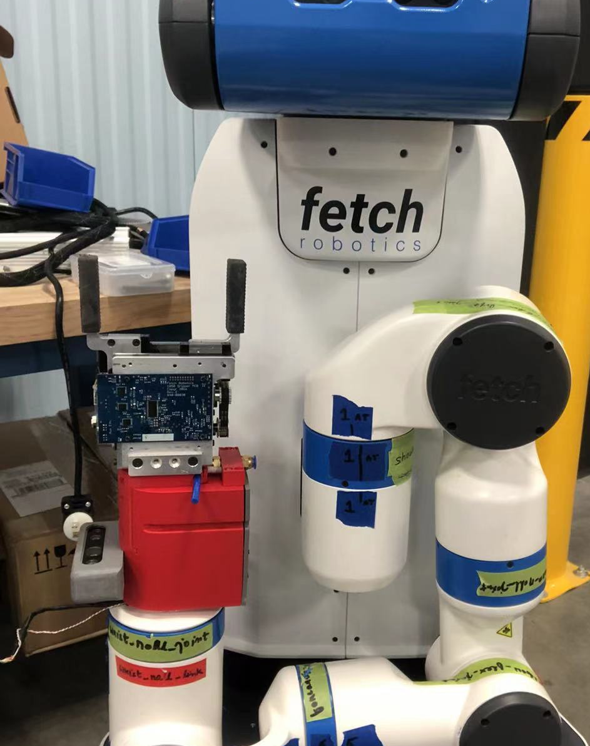

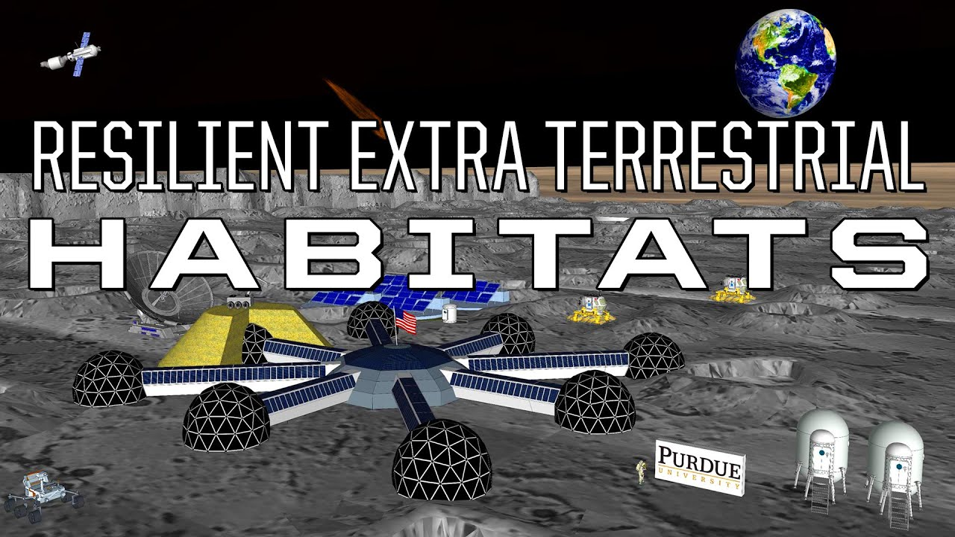
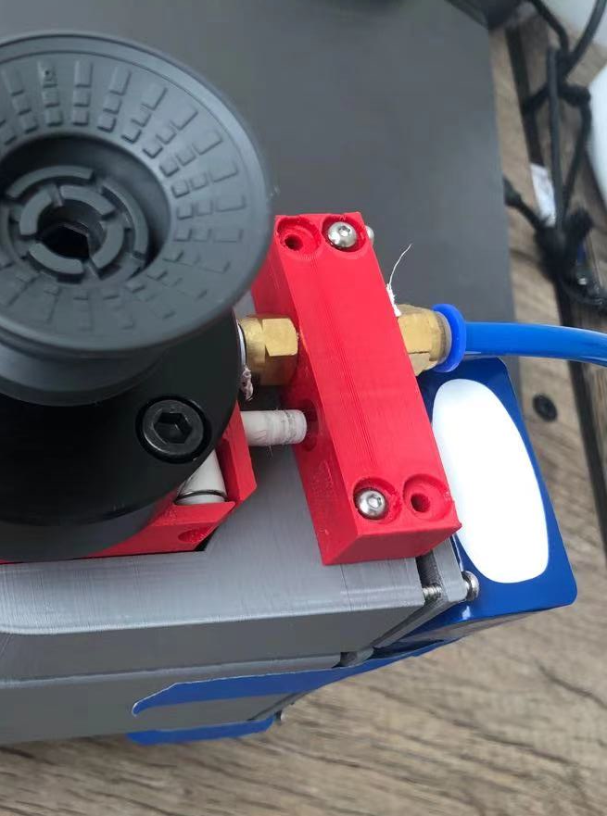
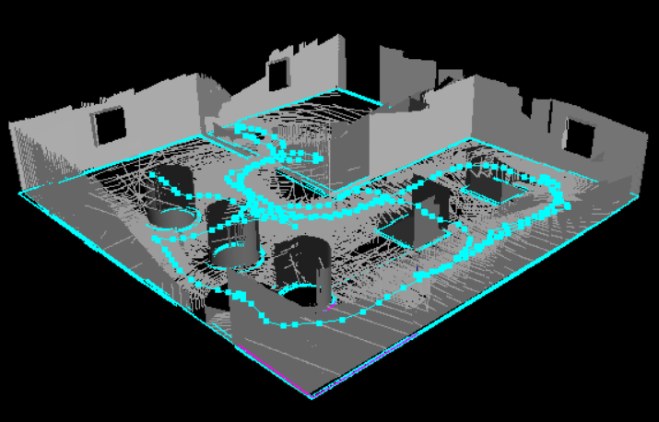
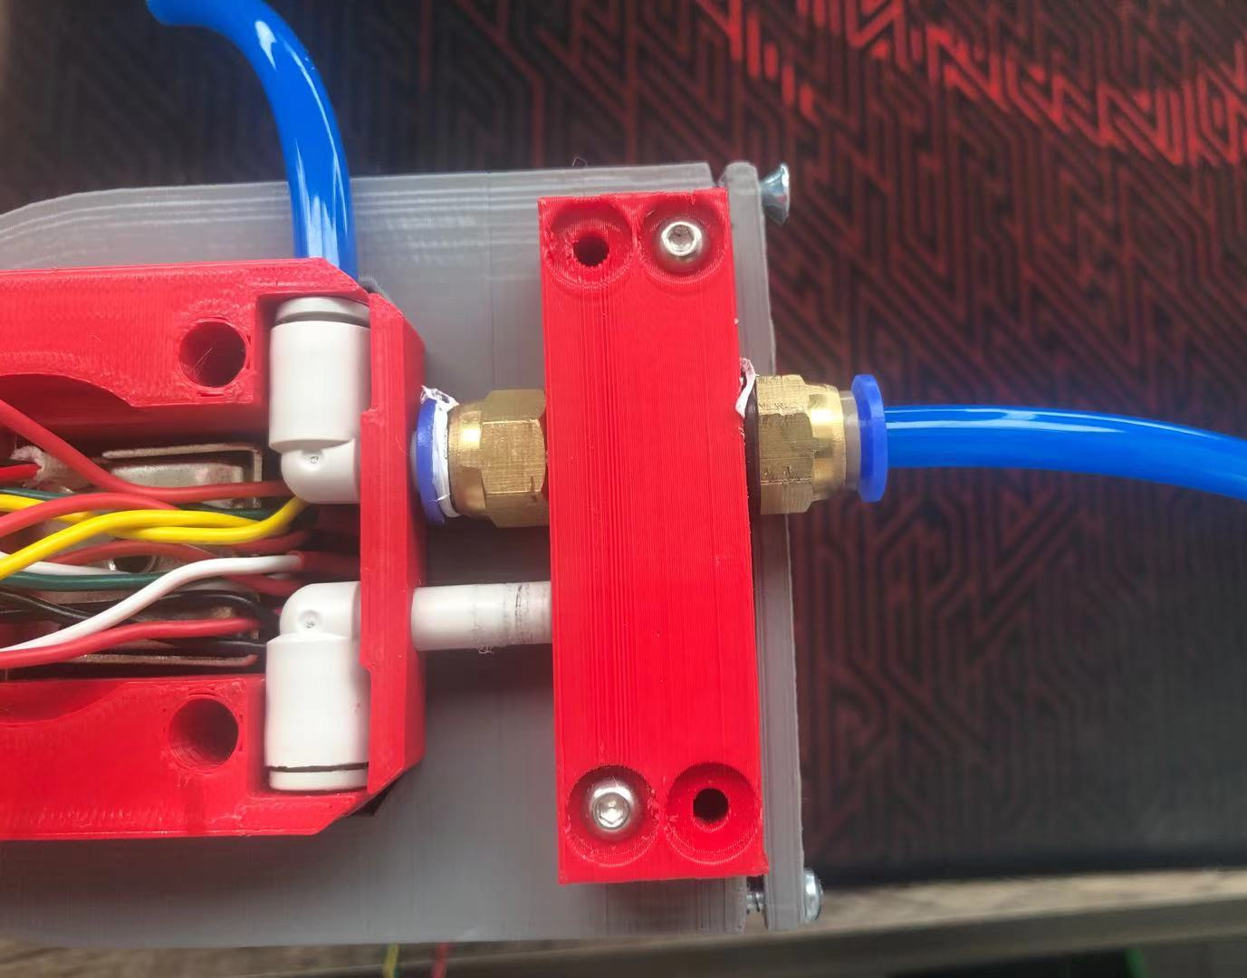
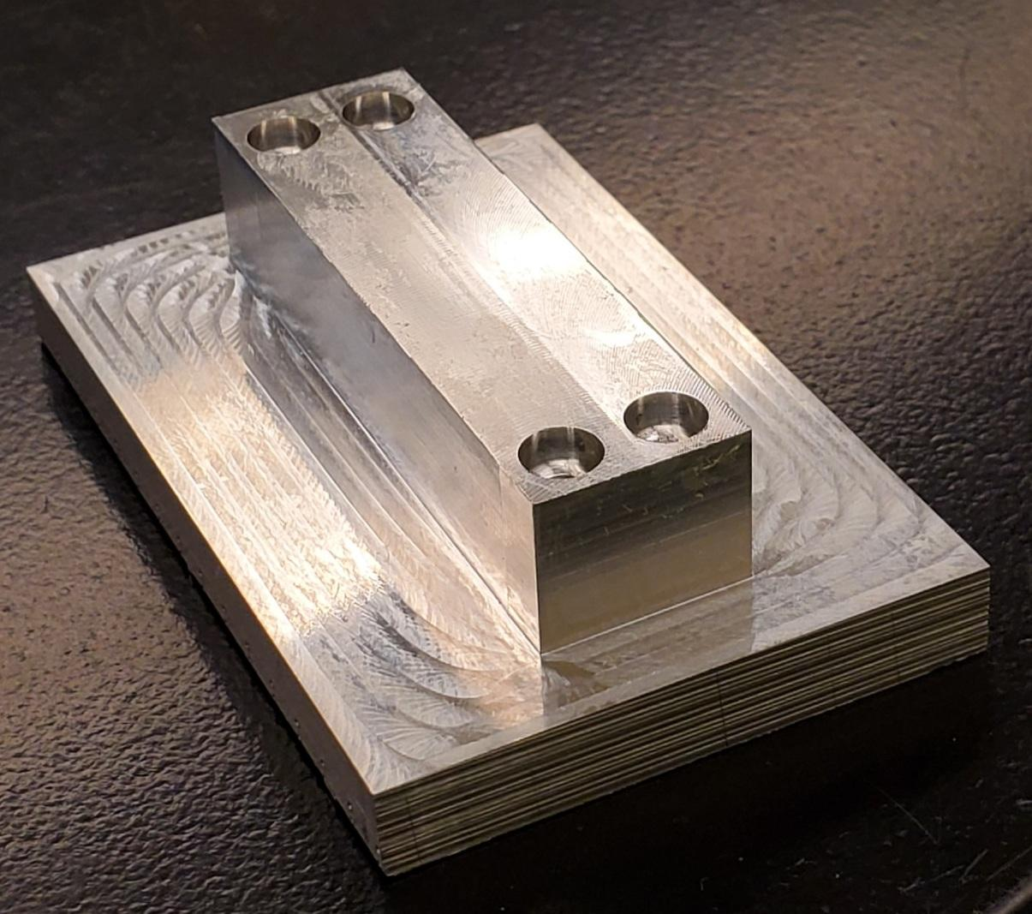
Development of a Modular End-Effector System and Autonomous Mapping Platform for Robotic Maintenance & Repair
Research Goals
Approaches
To support space exploration, the Resilient Extra Terrestrial Habitat Institute (RETHi) has goals of developing an environmental mapping and a modular end effector system to be compatible with robots that can autonomously repair and maintain resilient extraterrestrial habitats.
Modular End-Effector System
Utilize a modular pneumatic gripper tool end-effector
Vacuum pump instead of a pressurized air tank.
3D printed prototype (porous material) of PC6-01 connector mount.
Material jeopardizes air pressure and thus required manufacturing in aluminum instead.
Autonomous Mapping System
Robot Operating System (ROS) was used to build the system
Mapping prototypes trialed on a Turtlebot3 and ported to a Fetch robot, simulated on Gazebo
Used a trial world to simulate an explorable environment
Fetch Mobile Robot Platform
PC6-01 Connector
Holder
Modular
Gripper End-Effector
https://www.purdue.edu/reth/
https://www.purdue.edu/rethi/
Modular End-Effector System
Connector mount is being manufactured at Purdue’s Bechtel Innovation Design Center to prevent air leakage.
VF-2 CNC Mill, Bandsaw, Hand Tap
Results and Discussion
Conclusions
Autonomous Mapping System
System assumed a lower-cost Red Green Blue Depth (RGBD) camera (as opposed to a stereo camera) and the Fetch robot’s built-in laser rangefinder
Visual Simultaneous Localization and Mapping (vSLAM) uses sensor information to explore, navigate through, and build a 3D map of the environment
Autonomously determines where it can go and maps those areas
A successful robot will be able to:
Autonomously navigate to a maintenance/repair site.
Choose the appropriate end-effectors and tools needed.
Complete the repair or maintenance task.
This project is continuously being worked on to improve the efficiency of various systems.
Simulated World Mapping
As the leading university in this NASA funded project, further developments are planned to improve the productivity and efficiency of the various end effectors and mapping algorithm.
3D printed mount directing airflow
Partially manufactured mount
Agathiya Tharun and Eric Mesina | FYE Purdue ‘24
Advisor: David J. Cappelleri, School of Mechanical Engineering

